Slide 1


Research Paper Final Presentation
James Cogswell
CYSE 491-001
Fall 2020

Slide 2
Contents
Overview of Senior Design Project
Research Area
Introduction to Compression
Introduction to Encryption
Asymmetric Encryption
Symmetric Encryption
Comparing the two
Combining the Two
Choosing the Right Encryption
Current Status of the Technology
Technology Extension
Practical Contribution of the Technology
Conclusion
Technology Paper Evaluation
References

Slide 3
Overview of Senior Design Project
Packer/Loader Part II
Expansion of Part I to include Linux capabilities
Improvement of existing Windows capabilities
Encrypt and compress PE and ELF binary executables
Unique stub to avoid AV detection
Execute payload in remote host exclusively in memory

Slide 4
Research Area
Encryption
Identify the most platform-compatible encryption library
Secure, password-based encryption
Static compilation of components of encryption library
.lib for Windows
.a for Linux
Testing encryption libraries such as OpenSSL and Libsodium
Mapping relevant components of each (or either) library
Use only the necessary library files in static compilation to reduce overall size
No need for entire library of encryption algorithms

Slide 5
Research Area
Compression
Identify the most platform-compatible compression library
Static compilation of compression library components that will be used
.lib for Windows
.a for Linux
Utilizing industry standard UPX or potentially using the miniz library which is a stripped version of zlib
Like encryption, need to map the components of the library that will be necessary for both compression and decompression
Miniz compression seems to be the right choice given that UPX is very easily detected by antivirus

Slide 6
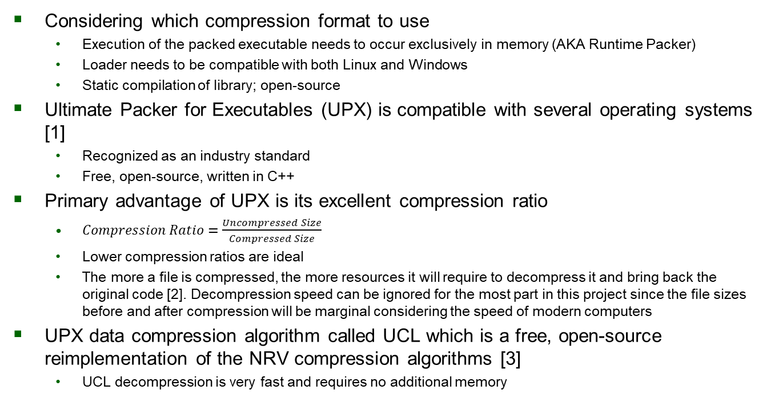
Introduction to Compression
Considering which compression format to use
Execution of the packed executable needs to occur exclusively in memory (AKA Runtime Packer)
Loader needs to be compatible with both Linux and Windows
Static compilation of library; open-source
Ultimate Packer for Executables (UPX) is compatible with several operating systems [1]
Recognized as an industry standard
Free, open-source, written in C++
Primary advantage of UPX is its excellent compression ratio
$Compression Ratio=\frac{Uncompressed Size}{Compressed Size}$
Lower compression ratios are ideal
The more a file is compressed, the more resources it will require to decompress it and bring back the original code [2]. Decompression speed can be ignored for the most part in this project since the file sizes before and after compression will be marginal considering the speed of modern computers
UPX data compression algorithm called UCL which is a free, open-source reimplementation of the NRV compression algorithms [3]
UCL decompression is very fast and requires no additional memory
Notes:
The more a file is compressed, the more resources it will require to decompress it and bring back the original code

Slide 7
Introduction to Compression
Compression types
Lossy
Doesn’t restore files to original form [4]
Compromises quality of data
AKA irreversible compression
Primarily used for compression of images, audio, and videos
Lossless
File is restored to its original form [4]
Preserves the quality of data
Primarily used for compression of programs, text files, etc. where missing data is very evident
UCL is a lossless compression algorithm that is ideal for this type of project

Slide 8
Introduction to Encryption
Countless number of encryption algorithms
Vary in security, complexity, compatibility, and practical use cases
Two main types
Asymmetric and Symmetric
Asymmetric encryption
Encryption is done using two keys – public and private
Public keys are known by trusted endpoints
Private keys are known only by the individuals
AKA Public Key Encryption (PKE)
Very commonly used today
Symmetric Encryption
Encryption is done with one key known by both the sender and the recipient
Some algorithms require a key that is equal in length to the data being encrypted
Key lengths don’t necessarily determine the security of a symmetric encryption algorithm and large key sizes can create storage issues since they effectively double the size of the file

Slide 9
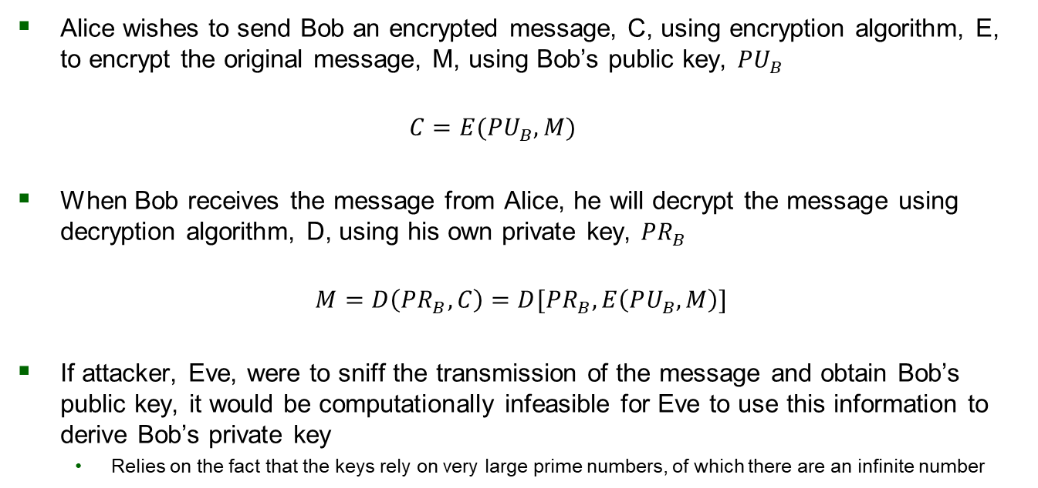
Asymmetric Encryption
Alice wishes to send Bob an encrypted message, C, using encryption algorithm, E, to encrypt the original message, M, using Bob’s public key, $PU_{B}$
$$C=E(PU_{B}, M)$$
When Bob receives the message from Alice, he will decrypt the message using decryption algorithm, D, using his own private key, $PR_{B}$
$$M=D\left(PR_{B},C\right)=D[PR_{B},E\left(PU_{B},M\right)]$$
If attacker, Eve, were to sniff the transmission of the message and obtain Bob’s public key, it would be computationally infeasible for Eve to use this information to derive Bob’s private key
Relies on the fact that the keys rely on very large prime numbers, of which there are an infinite number

Slide 10
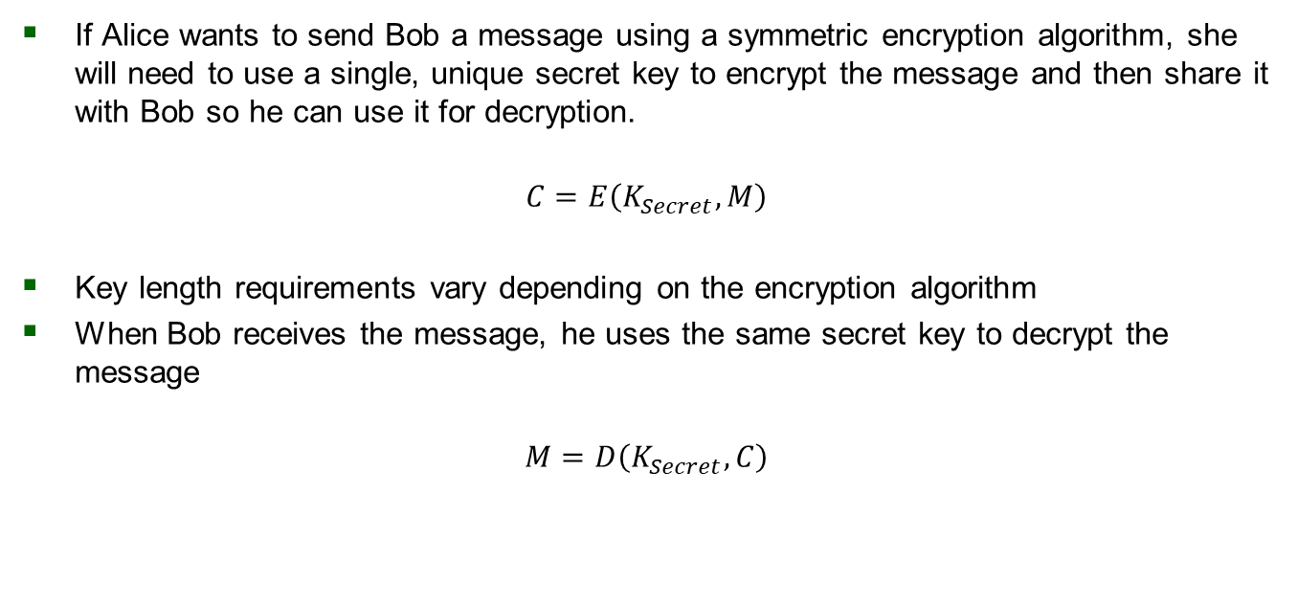
Symmetric Encryption
If Alice wants to send Bob a message using a symmetric encryption algorithm, she will need to use a single, unique secret key to encrypt the message and then share it with Bob so he can use it for decryption.
$$C=E\left(K_{Secret},M\right)$$
Key length requirements vary depending on the encryption algorithm
When Bob receives the message, he uses the same secret key to decrypt the message
$$M=D\left(K_{Secret},C\right)$$

Slide 11
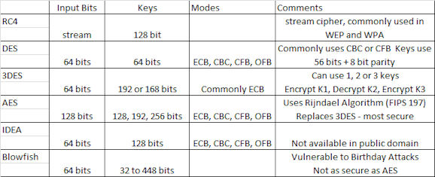
Symmetric Encryption
Symmetric encryption algorithms and their requirements [5]

Slide 12
Comparing the Two
Asymmetric encryption allows various parties to exchange encryption keys securely so they can communicate with each other over unsecure networks
Overall, asymmetric is more secure than symmetric since the algorithms are computationally infeasible to break, private keys are never shared, public keys can’t be used to derive the private key
Symmetric encryption is mostly used for encrypting data at rest and in banking where encrypting credit card numbers or other PII during transactions [6]
Symmetric encryption is faster than asymmetric since the keys are generally much smaller than asymmetric encryption
Symmetric isn’t as commonly used is because sharing a single key to encrypt/decrypt is a major security concern
How would Alice and Bob agree on a secret key over an unsecure network?
The choice between the two comes down to whether decryption will need to be performed by a person other than the original
Typically, if encrypting data at rest, use symmetric. If encrypting data to send over an unsecure network, use asymmetric

Slide 13
Combining the Two
Can we benefit from the speeds of symmetric and the security of asymmetric?
Can Alice use asymmetric and symmetric encryption together?
Yes, this is the most common form of encrypted communication
Alice and Bob could use PKE to establish a secure network tunnel between them where they can exchange secret keys which allows them to use symmetric encryption on their data
Diffie-Hellman Key Exchange (DHKE)
Improved since its inception to include more secure algorithms as a supplement to the overall structure
Elliptic Curve Cryptography (ECC) is one example
Elliptic Curve Diffie-Hellman (ECDH)

Slide 14
Choosing the Right Encryption
Lockheed Martin requires a password-based encryption algorithm
The password will be used for both encryption and decryption
Only symmetric encryption will be used for the packer/loader programs
Users of the packer are the only ones who need to know the password
An encrypted communication tunnel between the sender and receiver will be established prior to transmission of the packed executable
Static compilation of an open-source crypto library
OpenSSL
Libsodium
AES-256 encryption

Slide 15
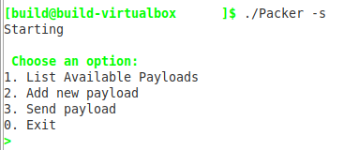
Current Status of the Technology
Part I of the Lockheed Martin Packer/Loader project works only for the Windows OS, but not for Linux
Packer program runs locally on a Linux machine and is capable of compressing and encrypting the payload using AES [7]
Loader program runs on remote Windows machine as a service awaiting transmission from the packer machine
When the packed executable is received, the loader decrypts and decompresses the payload and executes the code exclusively in RAM without ever touching disk [7]
Current program has a menu for the user to choose between several options
Packer Menu [7]

Slide 16
Current Status of the Technology
Protocol used for communication is secure file copy (SCP) which uses secure shell (SSH)
SCP is an added functionality of Linux CLI command cp and thus lacks support for non-Unix operating systems
To resolve this issue, third party software CYGWIN was used to use SCP on the Windows machine [7]
Many packers are in use today
Typically created by malware authors
Primary objective is to make it difficult to detect and reverse engineer the malware
Ensuring anti-virus programs are unable to unpack the executable is ideal
Runtime packers include a bit of unpacked code known as a stub
The stub has instructions for unpacking the malware once it reaches the target system’s memory [8]
The purpose of the packer is to hinder the anti-virus program’s ability to use a heuristic approach to detecting the malware since the packer aims to break signatures that the anti-virus will look for [8]

Slide 17
Current Status of the Technology
Jon Oberheide and his colleagues at the University of Michigan
Web-based application, PolyPack [9]
PolyPack uses ten packers and ten anti-malware engines to test effectiveness of the packers against all anti-malware engines
User submits a file to be packed → all ten packers pack the file → all ten anti-malware engines scan the ten different packed files
PolyPack reports the effectiveness of the anti-malware engines so the user can choose the most effective packer to use
Themida, a common publicly accessible packer today, scored highest over the others [9]
Themida originally created to protect commercial software crackers
2006, a survey conducted by BlackHat which found that 92% of malware programs are packed [10]
Malware packers are still very much a relevant topic for cyber defenders to understand

Slide 18
Technology Extension
Packers aren’t going anywhere – they’re still an effective tool that hackers use
In the past, packers were used for compressing executables to save network bandwidth and storage space in the disks of personal computers [11]
Much more important then; not a concern today
Today, the primary use for packers is to avoid detection by the endpoint’s AV
Just as AV companies are always looking for better ways to detect packed executables containing malware so they can protect their users from these types of attacks, malware authors concentrate their energy on evading detection and prevention measures

Slide 19
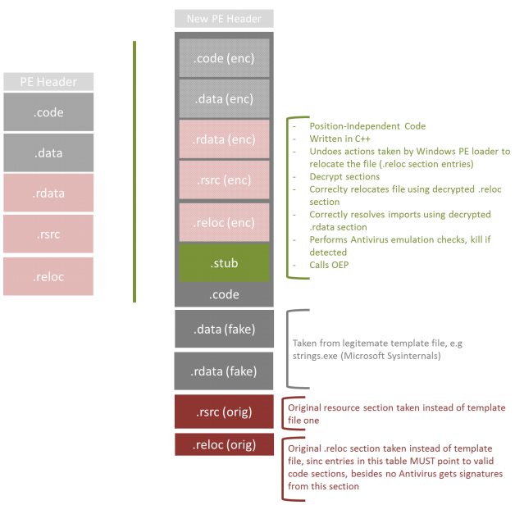
Technology Extension
Arne Swinnen and Alaeddine Mesbahi suggested a new method for writing packers that are more effective at avoiding detection
Requires the use of a ‘template file’ into which malcode will eventually be injected
Malcode will be encrypted and added to the template as a resource (i.e., .rsrc) in the header [12]
Header sections must appear legitimate and some may be left unencrypted
To avoid breaking the template executable, the section data needs to be located in the areas of memory that the target will be expecting
To do this, the packer calculates the memory location of the template on disk, saves the data encrypted at the location on disk in the newly packed executable
The stub is located after the encrypted data and will be the new first .text section of the PE file [12]
Swinnen and Mesbahi may have a new and unique method for improving the ability of packer programs to avoid detection, prevention, and reverse engineering efforts but it isn’t a standardized process.
The lack of standardization is one reason it’s so difficult to defend against
Malware authors can theoretically use an infinite number of methods to achieve their goals

Slide 20
Practical Contribution of the Technology
Execution of malcode exclusively in memory on a remote target without detection, prevention, or the ability to reverse engineer is an incredibly powerful tool in the hacker’s already massive arsenal
Cybersecurity engineers need to understand this complex technology in order to effectively prevent an attack from being performed using a packed executable
The best offense is a great defense
Packers grant hackers the ability to inject malcode into several different executables used in different attacks performed over time
Since the goal is to avoid detection and hinder the ability of security professionals to reverse engineer the executable, the malware may have a much longer lifespan
Signatures and exploits won’t be able to be quickly identified and added to anti-virus databases
Reusing the same malware for different attacks is a massive benefit to hackers since it isn’t trivial to identify and exploit vulnerabilities in today’s systems

Slide 21
Conclusion
Knowledge and understanding of the tools that hackers use is incredibly important for security professionals
More important now than ever to ensure that cyber defenders that are in the position to defend our infrastructure, assets, PII, etc. are just as good (or better) than those whom they are responsible for protecting
Defending citizens, critical infrastructure, customers of an organization, or an organization itself
The goal of runtime packers and loaders is to successfully inject malcode into an executable file, send it to a remote machine, decrypt and decompress the payload without detection, and run the payload exclusively in memory
No limit to the number of ways this can be done
Identifying the best encryption and compression requires lots of research, trial-and-error, and testing
Static compilation of encryption and compression libraries can be extremely large (and thus increase likelihood of detection) and should be considered

Slide 22
Technology Paper Evaluation
The paper has been instrumental in the planning and early development of the components which will be used in the packer. Time spent researching aligned perfectly with the Lockheed Martin project schedule and enabled a strong understanding of the fundamentals before practical application and development began.
Some requirements should be adjusted to allow students to use their creativity and judgement when researching and writing their paper. Although it was extremely helpful, the benefits could certainly be enhanced if there were less requirements which tend to guide research into directions that aren’t necessary for a successful project.
Consider making this a group project. It would help facilitate teamwork and all students would have a better understanding of the components that other members of the group are responsible for researching. Parts of this paper are consistent across the whole group and would therefore only need to be written once, while allowing all other technical sections to be researched and written by the students who is responsible for them.
Overall, extremely beneficial as-is.

Slide 23
References
[1] M. Oberhumer, “UPX: the Ultimate Packer for eXecutables - Homepage,” GitHub, Jan. 22, 2020. https://upx.github.io/ (accessed Oct. 25, 2020).
[2] M. Hawthorne, “What is Compression Ratio? definition & meaning,” Technipages, Aug. 16, 2019. https://www.technipages.com/definition/compression-ratio (accessed Oct. 26, 2020).
[3] M. Oberhumer, “UCL data compression library,” oberhumer.com, Jul. 20, 2004. http://www.oberhumer.com/opensource/ucl/ (accessed Oct. 25, 2020).
[4] MKS075, “Difference between Lossy Compression and Lossless Compression,” GeeksforGeeks, May 22, 2019. https://www.geeksforgeeks.org/difference-between-lossy-compression-and-lossless-compression/ (accessed Oct. 26, 2020).
[5] L. Pontarelli, “CCIE Study Notes: Version 4.1 - 2.0 Symmetric Encryption,” Blue Wolf Spirit, Jan. 31, 2017. http://www.bluewolfspirit.com/notes/security-written/version_41_20_symmetric_encryp.html (accessed Oct. 26, 2020).
[6] R. Yackel, “When to Use Symmetric vs. Asymmetric Encryption | Keyfactor - Security Boulevard,” Security Boulevard, Jun. 17, 2020. https://securityboulevard.com/2020/06/when-to-use-symmetric-vs-asymmetric-encryption-keyfactor/ (accessed Oct. 26, 2020).
[7] M. Palmer, C. Bai, H. Rowlette, A. Chapin, and A. Herrera, “Windows Packer/Loader,” George Mason University, 2020. Accessed: Oct. 10, 2020.
[8] R. Abrams, “An Introduction to Packers,” WeLiveSecurity, Oct. 28, 2008. https://www.welivesecurity.com/2008/10/27/an-introduction-to- packers/ (accessed Oct. 24, 2020).
[9] J. Oberheide, M. Bailey, and F. Jahanian. PolyPack: An Automated Online Packing Service for Optimal Antivirus Evasion. In Proceedings of the 3rd USENIX conference on Offensive technologies, August 2009.
[10] T. Brosch and M. Morgenstern. “Runtime packers: The hidden problem?” https://www.blackhat.com/presentations/bh-usa-06/BH-US-06- Morgenstern.pdf, 2006.
[11] P. O’Kane, S. Sezer, and K. McLaughlin, “Obfuscation: The Hidden Malware,” IEEE Security Privacy, vol. 9, no. 5, pp. 41–47, Sep. 2011, doi: 10.1109/MSP.2011.98.
[12] A. Swinnen and A. Mesbahi, “One packer to rule them all: Empirical identification, comparison and circumvention of current antivirus detection techniques.,” BlackHat USA, 2014. Available online: https://www.blackhat.com/docs/us-14/materials/us-14-Mesbahi-One-Packer- To-Rule-Them-All-WP.pdf.

